Slide 1
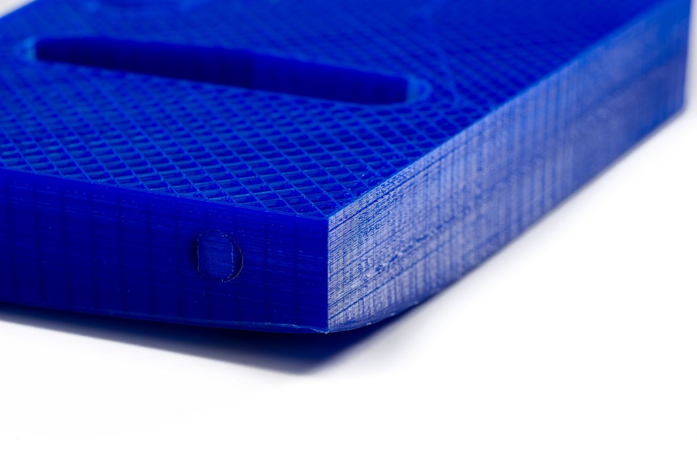
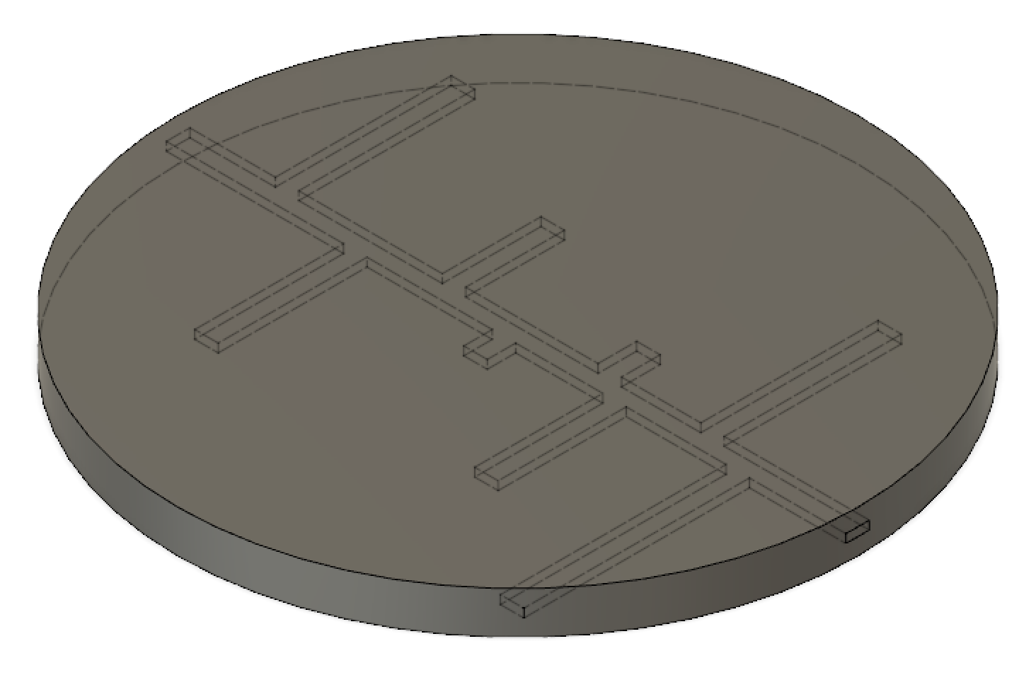
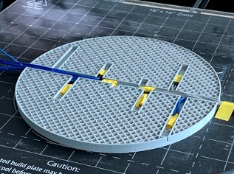
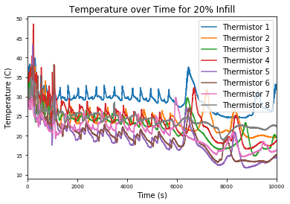
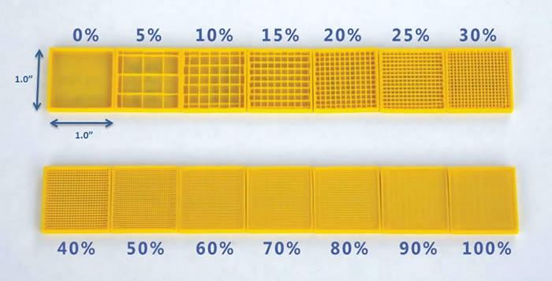
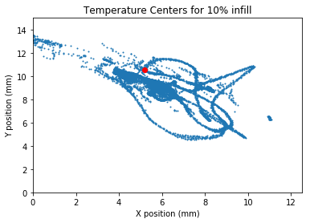
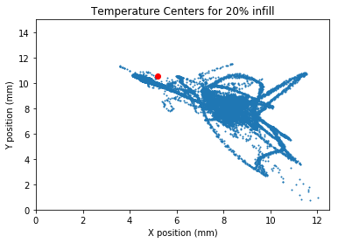
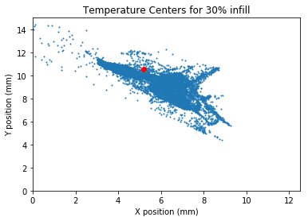


PURPOSE
The Effect of Infill Parameters on Spatiotemporal Thermal Distribution in Fused Deposition Modeling
RESULTS
3D printing has grown into a widely explored technology in many industries, such as construction, aerospace, and medicine, because of its ability to rapidly produce prototypes.
For many of these industries, the thermal properties of products are crucial to functionality. Therefore, it is critical to understand specific factors that influence these thermal properties.
During the 3D printing process, thermal stresses creates distortions, known as warpage. Limited research has been done on solutions to the warpage problem in FDM printing.
This study aims to understand the relationship between infill parameters and the spatiotemporal temperature distribution during the printing process.
For each calculated center, the weighted mean of the temperature was also calculated:
$$\frac{\sum{r_{i}T_{i}}}{\sum{r_{i}}}$$
where r is the distance from the center to the equilibrium point. The horizontal and vertical components of the gradient vector were also calculated for each center from the equilibrium point to find the magnitude and direction of net temperature change:
$$\text{∇}T=(\frac{∂T}{∂x}, \frac{∂T}{∂y})$$
A Welch’s Test was run on the resultant gradients for each infill:
Table 2: Welch’s Tests p-values and Test Statistics
EXPERIMENTAL DESIGN
Designed CAD model of an 8-inch diameter, 0.5 inch thick disc with 14mm wide channels
Sliced the model three times using a rectilinear infill pattern with 10%, 20%, and 30% infill percentage
Print the sliced model on the gCreate gMax 1.5XT+ with PLA and print settings in Table 1
Embed 8 NTC thermistors into the channels and record data using an Arduino Voltage Circuit and puTTY
10% and 20% infills
Test Statistic | -34.9745
p-value (two-tailed) | <0.0001
p-value (one-tailed) | <0.0001
20% and 30% infills
Test Statistic | -8.4609
p-value (two-tailed) | < 0.0001
p-value (one-tailed) | < 0.0001
Table 1: Printer Settings for All Prints. Settings not mentioned were left as the default values.
Setting | Value
Extruder Temperature | 200°C
Bed Temperature | 80°C
Layer Height | 0.2 mm
Figure 1: Warpage in 3D printing
3dprinting.com/tips-tricks/how-to-choose-an-infill-for-your-3d-prints
Figure 3: CAD model of template disc
Figure 4: Embedding thermistors during printing
BACKGROUND
DATA
CONCLUSIONS
Fused deposition modeling (FDM) is the most popular method for 3D printing due to its low production costs. In FDM, a thermoplastic filament is melted and extruded onto a surface repeatedly to produce a 3D object.
Warpage occurs as cycles of heating and cooling layers cause thermal stresses of expansion and contraction.
Plastic is used as filament in 3D printing. The discontinuous atomic nature of plastic causes its heat properties to be anisotropic and influenced by the internal structure, or infill.
Infill percentage refers to the proportion of plastic in an 3D printed object.
Current research on this topic fails to account for environmental factors as well as failing to consider factors that affect thermal properties.
Table 2: Sample Section of Raw Data from 20% Infill Print
The Welch’s Tests showed that the mean gradients for the 30% infill were significantly greater (p<0.0001) than the mean gradients for 20% infill. Additionally, the mean gradients for the 20% infill were also significantly greater (p<0.0001) than the mean gradients for the 10% infill. Therefore, this data suggests that as infill percentage increases, the mean gradient from equilibrium also increases, and since the gradient is directly proportional to the heat flux density as per Fourier’s Law, the net heat flow also increased.
Figures 6, 7, and 8 show that as infill percentage increased, the “clustering” of the centers around the equilibrium point tended to increase as well, showing that greater infill percentages led to more uniformity in the temperature distribution.
Therefore, this experiment’s data supported the hypothesis.
Time (seconds) | Thermistor 1 (°C) | Thermistor 2 (°C) | Thermistor 3 (°C) | Thermistor 4 (°C) | Thermistor 5 (°C) | Thermistor 6 (°C) | Thermistor 7 (°C) | Thermistor 8 (°C)
618 | 31.93 | 30.48 | 28.34 | 29.41 | 24.36 | 26.66 | 24.46 | 26.26
619 | 31.84 | 30.09 | 28.14 | 29.31 | 24.36 | 26.66 | 24.56 | 26.36
620 | 31.84 | 29.7 | 27.94 | 29.31 | 24.46 | 26.56 | 24.46 | 26.36
621 | 31.84 | 29.41 | 27.75 | 29.22 | 24.56 | 26.56 | 24.46 | 26.36
622 | 31.84 | 29.12 | 27.65 | 29.31 | 24.66 | 26.46 | 24.46 | 26.36
623 | 31.84 | 28.92 | 27.55 | 29.31 | 24.56 | 26.46 | 24.36 | 26.36
624 | 31.84 | 28.63 | 27.55 | 29.61 | 24.66 | 26.36 | 24.36 | 26.36
Figure 5: Graph of Temperature vs. Time for all thermistors
RESULTS
At any time t, the entire system is at a steady state temperature since the rate of heat flow into the system is the rate of heat flow out of the system. Therefore, it can be modeled by Fourier’s Law of Heat Conduction, where $\vec{q}$is the heat flux density, k is the thermal conductivity, and $\text{∇T}$ is the temperature gradient:
$$\vec{q}=−k\text{∇}\text{T}$$
Since the system at any time is at a steady-state, and the temperature gradient is directly proportional to the heat flux density, the center of temperature distribution can be found similarly to finding the center of mass assuming linear masses. In this system, each point can be assigned a “weight” that represents its temperature. The center can then be calculated by finding the weighted mean in the horizontal (x) and vertical (y) distances:
Center of Temperature = ( $\frac{\sum{x_{i}T_{i}}}{\sum{T_{i}}}$, $\frac{\sum{y_{i}T_{i}}}{\sum{T_{i}}}$)
When all temperatures are equal to each other, the center of temperature represents a common equilibrium point for when the entire system is at a perfect steady-state thermal equilibrium, and the weighted mean can be calculated with all weights equal:
Equilibrium Point = (5.175, 10.525)
FUTURE WORK
The conclusions in this study are based on limited data, and repeating this experiment with multiple trials of each infill would reduce the variability of data for each point and allow for more accurate generalizations of a relationship.
More infill percentages can also be printed to investigate whether the suggested relationship is maintained. Other parameters can also be considered, such as infill pattern and filament material or color.
As temperature is a scalar function, to accurately analyze the temperature gradients in this experiment, the function must be known. Future research on finding this function using scattered, discrete temperature values can be conducted, such as by using Deep Learning models like Artificial Neural Networks to produce mapping functions for the data.
Figure 2: Various infill percentages
tcadsolutions.com/3dprinting.html
HYPOTHESIS
Greater infill percentages will have more uniform distributions of temperature because conduction has been shown to be more effective than radiation or convection for heat transfer in enclosed structures.
IV: Infill percentage (10%, 20%, 30%)
DV: Temperature at specific points over time
Figure 6: 10% infill temperature centers, STD_{x} = 0.87, STD_{y} = 0.59
Figure 7: 20% infill temperature centers, STD_{x} = 1.40, STD_{y} = 0.94
Figure 8: 30% Infill temperature centers, STD_{x} = 0.87, STD_{y} = 0.64

